Slide 1




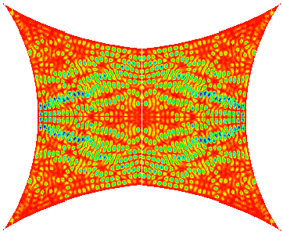
When Waves Meet Chaos: A Clash of Paradigms
Steven M. Anlage
Distinguished Scholar-Teacher Lecture
29 November, 2016
Research funded by AFOSR and ONR
Notes:
6 hours including questions

Slide 2
Wave / Particle Duality
Wave-Like Properties
Particle-Like Properties
Waves
Diffraction
Photons
Photo-Electric Effect
Compton Scattering
Matter
Electron Diffraction
Quantum point contact
Billiards
Maxwell’s Equations
Schrödinger Equation
Newton’s Laws of Motion
Equations,
Properties and
Phenomena
Wavelength λ
Point Particles
Forces, Energy, Momentum
Trajectories, Collisions
Discrete Modes
Eigenvalues
Eigenfunctions
¿Wave Chaos?
¿Quantum Chaos?
Chaos

Slide 3
Outline
Classical Chaos
What is Wave Chaos?
Universal Statistical Properties of Wave Chaotic Systems
The Microwave Billiard Experiment
  Statistical Properties of Closed Wave Chaotic Systems
  Properties of Open / Scattering Wave Chaotic Systems
  The Problem of Non-Universal and System-Specific Effects
  Wireless Power Transfer and Wave Chaos (Gemstone Team TESLA)
Conclusions

Slide 4
Simple Chaos
1-Dimensional Iterated Maps
The Logistic Map:
Parameter:
Initial condition:
x
x
x
Iteration number
Iteration number
Iteration number

Slide 5
Extreme Sensitivity to Initial Conditions
1-Dimensional Iterated Maps
The Logistic Map:
Change the initial condition (x₀) slightly…
x
Although this is a deterministic system,
Extreme sensitivity to initial conditions
Difficulty in making long-term predictions
Sensitivity to noise
Iteration Number

Slide 6
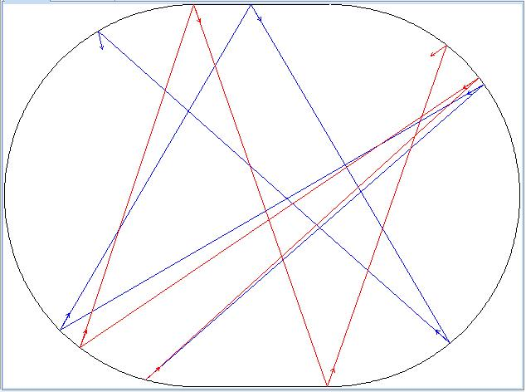
Classical Chaos in Newtonian Billiards
Best characterized as “extreme sensitivity to initial conditions”
Regular system
Chaotic system
Newtonian
particle
trajectories
x_{i}, p_{i}
x_{i}+Δx_{i}, p_{i} +Δp_{i}
x_{i}, p_{i}
x_{i}+Δx_{i}, p_{i} +Δp_{i}
2-Dimensional “billiard” tables
Hamiltonian

Slide 7
Outline
Classical Chaos
What is Wave Chaos?
Universal Statistical Properties of Wave Chaotic Systems
The Microwave Billiard Experiment
  Statistical Properties of Closed Wave Chaotic Systems
  Properties of Open / Scattering Wave Chaotic Systems
  The Problem of Non-Universal and System-Specific Effects
  Wireless Power Transfer and Wave Chaos (Gemstone Team TESLA)
Conclusions

Slide 8
Wave Chaos?
1) Waves do not have trajectories
It makes no sense to talk about
“diverging trajectories” for waves
2) Linear wave systems can’t be chaotic
Maxwell’s equations, Schrödinger’s equation are linear
3) However in the semiclassical limit, you can think about rays
In the ray-limit
it is possible to define chaos
“ray chaos”
Wave Chaos concerns solutions of linear wave equations which,
in the semiclassical limit, can be described by chaotic ray trajectories

Slide 9
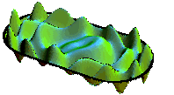
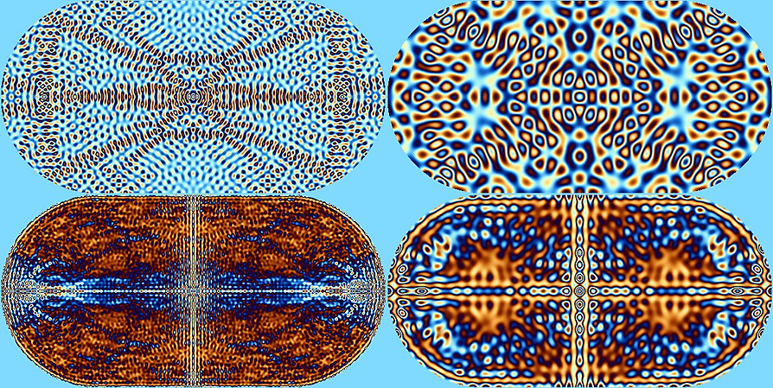
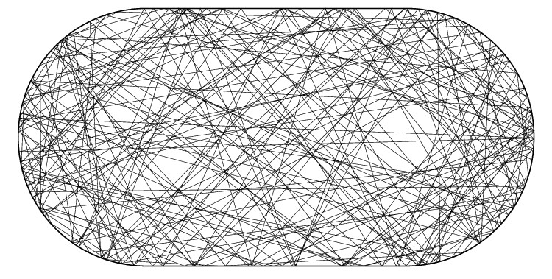
From Classical to Wave Chaos
wave
Quantum
Semiclassical limit
(quantum chaos)
ray trajectory
Classical
(chaos)

Slide 10
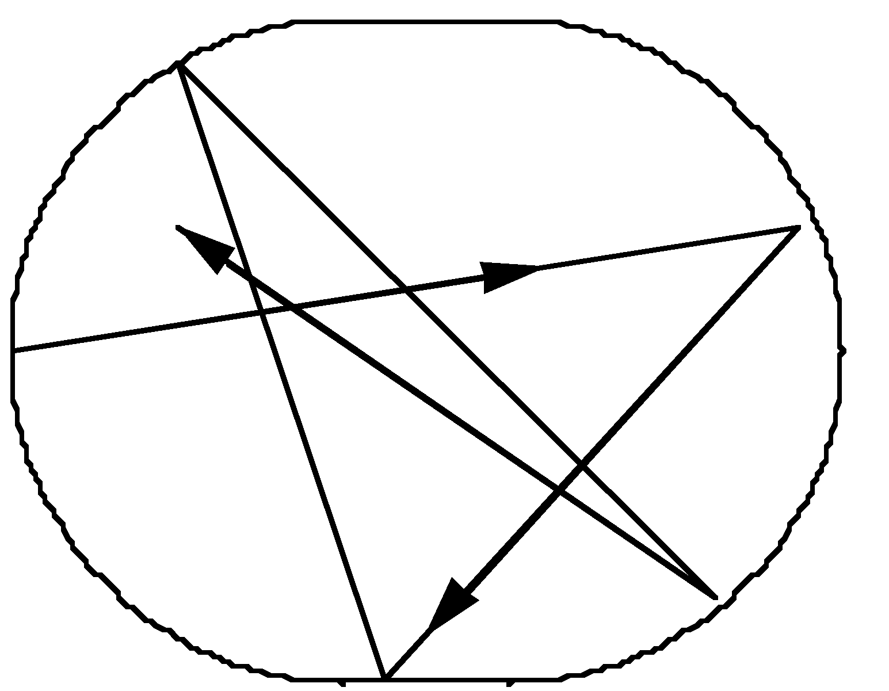
How Common is Wave Chaos?
Consider an infinite square-well potential (i.e. a billiard) that shows chaos in the classical limit:
Sinai billiard
Bunimovich Billiard
Hard Walls
Bow-tie
Bunimovich stadium
L
Solve the wave equation in the same potential well
Examine the solutions in the semiclassical regime: 0 < λ << L
Some example physical systems:
Nuclei, 2D electron gas billiards, acoustic waves in irregular blocks or rooms, electromagnetic waves in enclosures
Will the chaos present in the classical limit have an affect on the wave properties?
YES
But how?

Slide 11
Outline
Classical Chaos
What is Wave Chaos?
Universal Statistical Properties of Wave Chaotic Systems
The Microwave Billiard Experiment
  Statistical Properties of Closed Wave Chaotic Systems
  Properties of Open / Scattering Wave Chaotic Systems
  The Problem of Non-Universal and System-Specific Effects
  ‘Wireless Power Transfer and Wave Chaos (Gemstone Team TESLA)
Conclusions

Slide 12
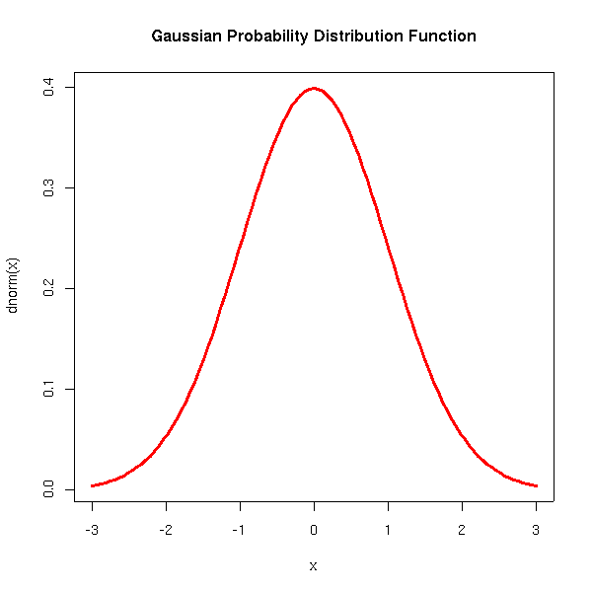
Random Matrix Theory (RMT)
Wigner; Dyson; Mehta; Bohigas …
The RMT Approach:
Complicated Hamiltonian: e.g. Nucleus: Solve
Replace with a Hamiltonian with matrix elements chosen randomly
from a Gaussian distribution
Examine the statistical properties of the resulting Hamiltonians
Orthogonal (real matrix elements, β = 1)
Unitary (complex matrix elements, β = 2)
Symplectic (quaternion matrix elements, β = 4)
Universality Classes of RMT:
Hypothesis: Complicated Quantum/Wave systems that have chaotic classical/ray
counterparts possess universal statistical properties described by
Random Matrix Theory (RMT) “BGS Conjecture”
Cassati, 1980
Bohigas, 1984
This hypothesis has been tested in many systems:
Nuclei, atoms, molecules, quantum dots, acoustics (room, solid body, seismic),
optical resonators, random lasers,…
Some Questions to Investigate:
Is this hypothesis supported by data in other systems?
What new applications are enabled by wave chaos?
Can losses / decoherence be included?
What causes deviations from RMT predictions?

Slide 13
Outline
Classical Chaos
What is Wave Chaos?
Universal Statistical Properties of Wave Chaotic Systems
The Microwave Billiard Experiment
  Statistical Properties of Closed Wave Chaotic Systems
  Properties of Open / Scattering Wave Chaotic Systems
  The Problem of Non-Universal and System-Specific Effects
  Wireless Power Transfer and Wave Chaos (Gemstone Team TESLA)
Conclusions

Slide 14
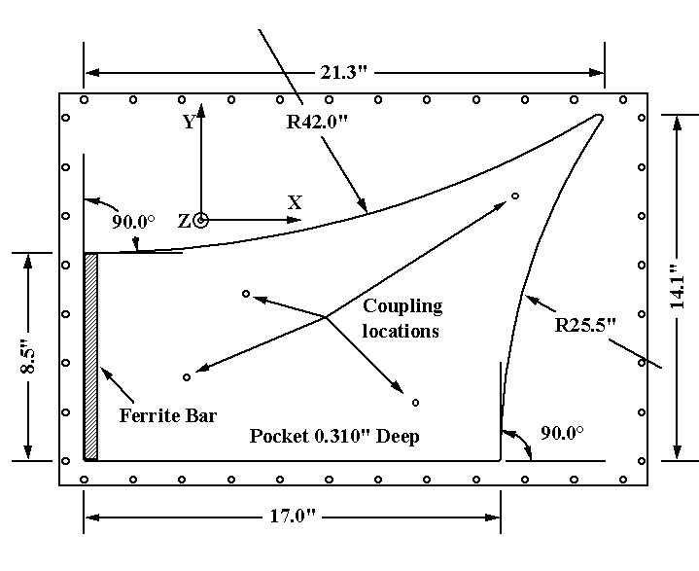
Microwave Cavity Analog of a
2D Quantum Infinite Square Well
Table-top experiment!
~ 50 cm
E_{z}
The only propagating
mode for f < c/d:
d ≈ 8 mm
Metal walls
B_{x}
B_{y}
An empty “two-dimensional” electromagnetic resonator
Schrödinger equation
Helmholtz equation
Stöckmann + Stein, 1990
Doron+Smilansky+Frenkel, 1990
Sridhar, 1991
Richter, 1992
Bow-Tie Billiard
A. Gokirmak, et al. Rev. Sci. Instrum. 69, 3410 (1998)

Slide 15
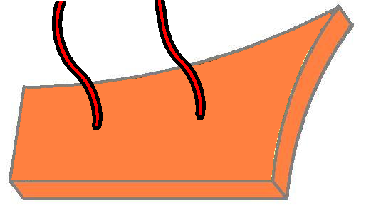
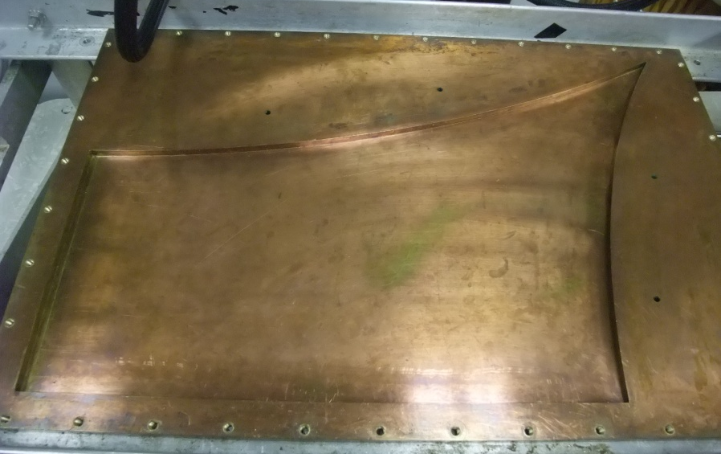
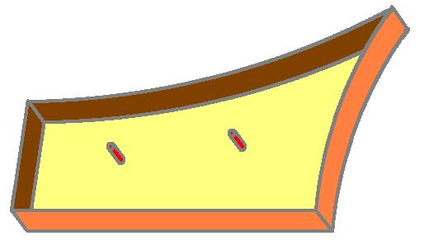
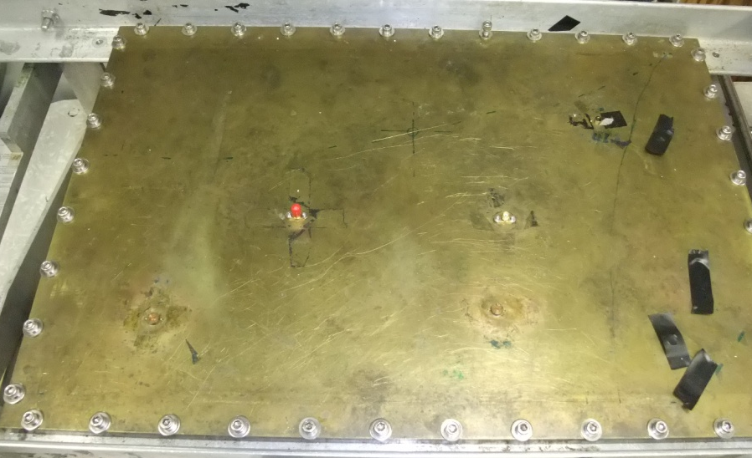
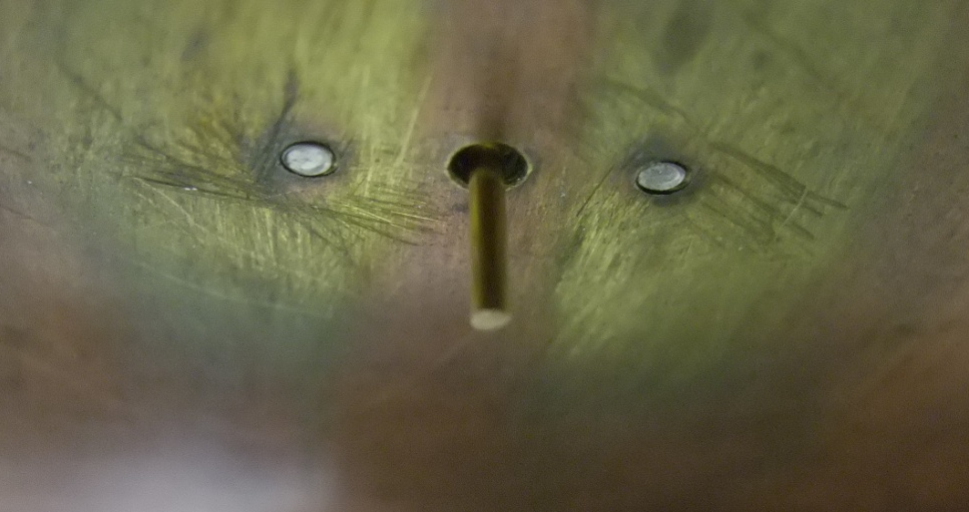
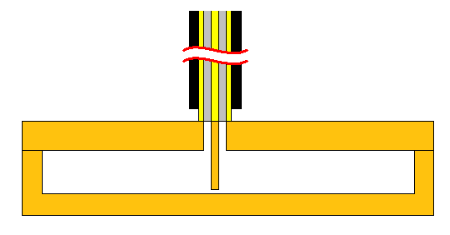
The Experiment:
A simplified model of wave-chaotic scattering systems
ports
21.6 cm
λ
43.2 cm
A thin hollow metal box
Coaxial
cable
Side view
0.8 cm
E_{z}

Slide 16
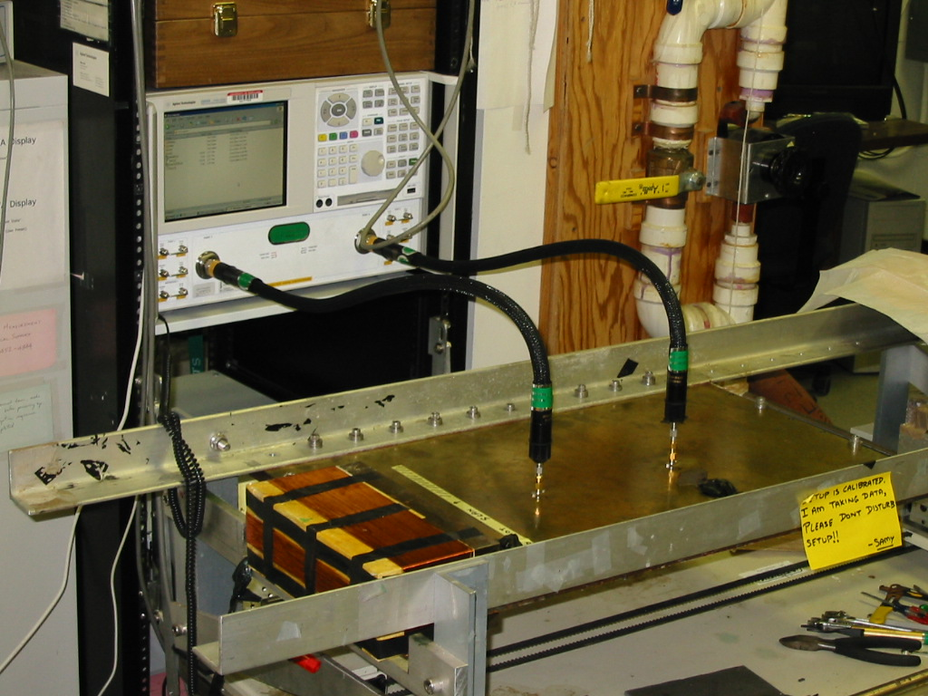
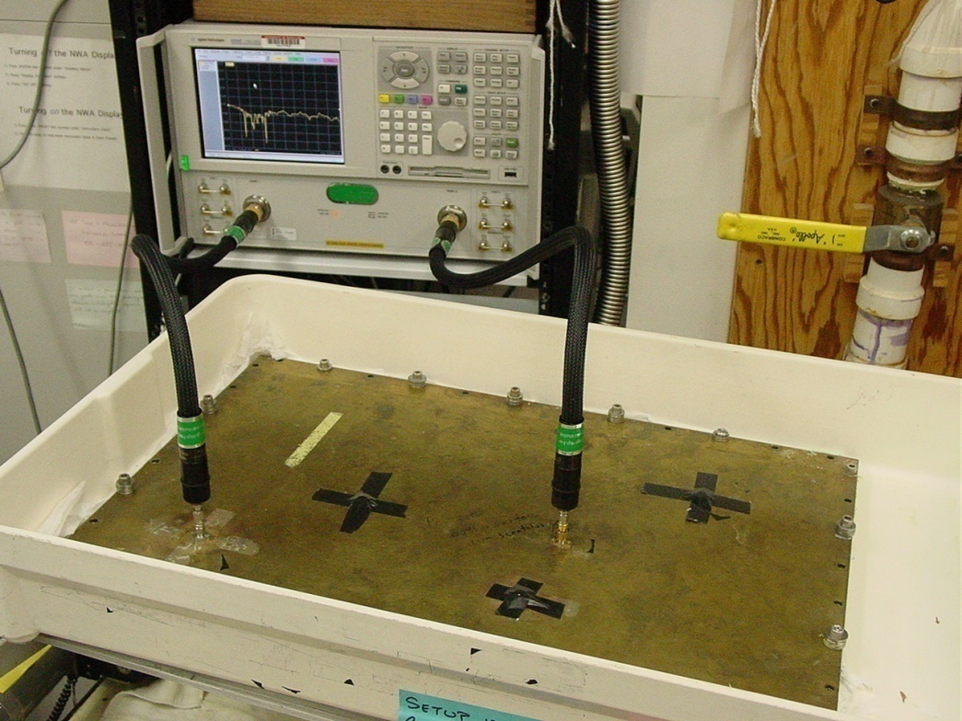
Microwave-Cavity Analog of a 2D
Infinite Square Well
with Coupling to Scattering States
Network Analyzer (measures S-matrix vs. frequency)
Electromagnet
Thin Microwave Cavity
Ports
We measure from 500 MHz – 19 GHz, covering about 750 modes in the semi-classical limit

Slide 17
Outline
Classical Chaos
What is Wave Chaos?
Universal Statistical Properties of Wave Chaotic Systems
The Microwave Billiard Experiment
  Statistical Properties of Closed Wave Chaotic Systems
  Properties of Open / Scattering Wave Chaotic Systems
  The Problem of Non-Universal and System-Specific Effects
  Wireless Power Transfer and Wave Chaos (Gemstone Team TESLA)
Conclusions

Slide 18
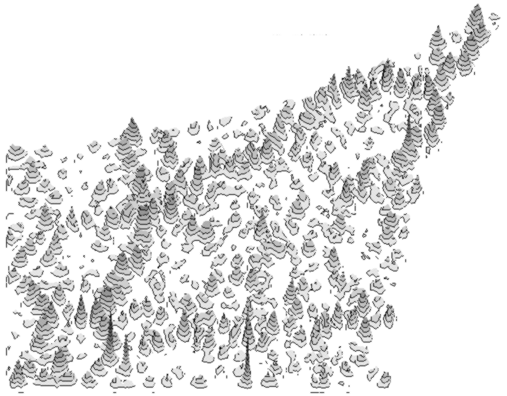
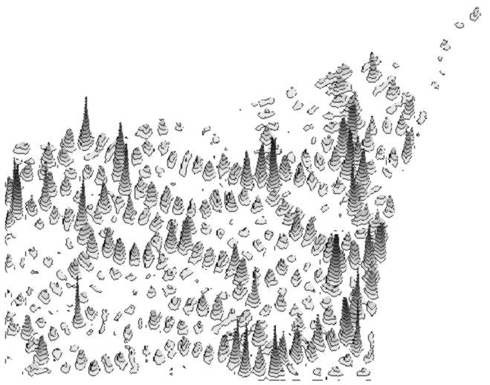
Wave Chaotic Eigenfunctions (~ closed system)
with and without Time Reversal Invariance (TRI)
r = 106.7 cm
B_{ext}
a)
TRI Broken
(GUE)
A magnetized
ferrite in the
cavity breaks
TRI
20
r = 64.8 cm
10
Time-reversal invariant
13.62 GHz
0
b)
Gaussian random
variables
0 10 20 30 40
y (cm)
Ferrite
20
18
TRI Preserved
(GOE)
De-magnetized
ferrite
15
12
8
10
4
2
A
0
Time-reversal invariance Broken
|
Ψ
|
13.69 GHz
0
0 10 20 30 40
x (cm)
D.-H Wu, J. S. A. Bridgewater, Ali Gokirmak, and S. M. Anlage,
Phys. Rev. Lett. 81, 2890 (1998).

Slide 19
Probability Amplitude Fluctuations
with and without Time Reversal Invariance (TRI)
White area
(TRI)
Broken TRI
Gray area
(Broken TRI)
(TRI)
Spikes
(2πν)^{-1/2} e^{-ν/2} TRI (GOE)
e^{-ν} TRI Broken (GUE)
D. H. Wu, et al.
Phys. Rev. Lett. 81, 2890 (1998).
RMT
Prediction:
P(ν) =

Slide 20
Outline
Classical Chaos
What is Wave Chaos?
Universal Statistical Properties of Wave Chaotic Systems
The Microwave Billiard Experiment
  Statistical Properties of Closed Wave Chaotic Systems
  Properties of Open / Scattering Wave Chaotic Systems
  The Problem of Non-Universal and System-Specific Effects
  Wireless Power Transfer and Wave Chaos (Gemstone Team TESLA)
Conclusions

Slide 21
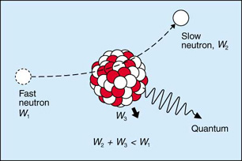
Chaos and Scattering
Hypothesis: Random Matrix Theory quantitatively describes the statistical
properties of all wave chaotic systems (closed and open)
Compound nuclear reaction
Nuclear scattering:
Ericson fluctuations
Incoming Channel
Outgoing Channel
Proton energy
Transport in 2D quantum dots:
Universal Conductance Fluctuations
μm
Billiard
Resistance (kΩ)
Outgoing Voltage waves
Incoming
Channel
Outgoing
Channel
B (T)
Incoming Voltage waves
Electromagnetic Cavities:
Complicated S₁₁, S₂₂, S₂₁
versus frequency
2
1

Slide 22

Universal Scattering Statistics
Despite the very different physical circumstances, these measured
scattering fluctuations have a common underlying origin!
Im[S]
Universal Properties of the Scattering Matrix:
$$φ_{n}$$
Re[S]
Unitary Case
RMT prediction: Eigenphases of S uniformly distributed on the unit circle
Eigenphase
repulsion
Nuclear Scattering
Cross Section
2D Electron Gas
Quantum Dot
Resistance
Microwave Cavity
Scattering Matrix,
Impedance, Admittance, etc.
Notes:
Degeneracies are completely broken in Quantum chaotic systems. Beta is an inverse temperature.

Slide 23
Statistical Properties of Scattering Systems
Universal Z (reaction) and S statistics
Inclusion of loss: P_{α}(Z), P_{α}(S)
α = 3-dB bandwidth / mean-spacing
Phys. Rev. Lett. 94, 014102 (2005)
Phys. Rev. E 74 , 036213 (2006)
Universal Conductance (G) Fluctuations
Decoherence ↔ Loss
γ = 4 π α
Phys. Rev. B 74, 195326 (2006)
Removing Non-Universal Effects:
Sensitivity to Details
Coupling, Short Orbits
Phys. Rev. E 80, 041109 (2009)
Phys. Rev. E 81, 025201(R) (2010)

Slide 24
Outline
Classical Chaos
What is Wave Chaos?
Universal Statistical Properties of Wave Chaotic Systems
The Microwave Billiard Experiment
  Statistical Properties of Closed Wave Chaotic Systems
  Properties of Open / Scattering Wave Chaotic Systems
  The Problem of Non-Universal and System-Specific Effects
  Wireless Power Transfer and Wave Chaos (Gemstone Team TESLA)
Conclusions

Slide 25
Universal Fluctuations are Usually Obscured by
Non-Universal System-Specific Details
Wave-Chaotic systems are sensitive to details
The Most Common Non-Universal Effects:
Non-Ideal Coupling between external scattering states and internal modes (i.e. Antenna properties)
2) Short-Orbits between the antenna and fixed walls of the billiards
Z-mismatch at interface of port and cavity.
Ray-Chaotic Cavity
Port
Short
Orbits
Incoming wave
“Prompt” Reflection due to Z-Mismatch between antenna and cavity
Transmitted wave

Slide 26
The Random Coupling Model
http://anlage.umd.edu/RCM
Divide and Conquer!
Coupling Problem
Enclosure Problem
Solution: Radiation Impedance Matrix Z_{rad}
+ Short Orbits
Solution: Random Matrix Theory;
Electromagnetic statistical properties are
governed by Loss Parameter α = k²/(Δk_{n}² Q) = δf_{3dB}/Δf_{spacing}
Mean
part
Fluctuating Part
(depends on α)
<Imξ> = 1
<Reξ > = 0
Electromagnetics 26, 3 (2006)
Electromagnetics 26, 37 (2006)
Phys. Rev. Lett. 94, 014102 (2005)
IEEE Trans. EMC 54, 758 (2012)

Slide 27
Testing Insensitivity to System Details
Coaxial
Cable
Freq. Range : 9 to 9.75 GHz
Cavity Height : h= 7.87mm
Statistics drawn from 100,125 pts.
Cross
Section
View of
Port
CAVITY LID
Radius (a)
CAVITY BASE
RAW Impedance PDF
NORMALIZED Impedance PDF
2a=0.635mm
2a=0.635mm
2a=1.27mm
Probability Density
2a=1.27mm

Slide 28
Outline
Classical Chaos
What is Wave Chaos?
Universal Statistical Properties of Wave Chaotic Systems
The Microwave Billiard Experiment
  Statistical Properties of Closed Wave Chaotic Systems
  Properties of Open / Scattering Wave Chaotic Systems
  The Problem of Non-Universal and System-Specific Effects
  Wireless Power Transfer and Wave Chaos (Gemstone Team TESLA)
Conclusions

Slide 29
Time Reversal Cavity
RECEIVE MODE
Heterogeneous Medium
Elementary transducers
ACOUSTIC SOURCE
Sonas
TRANSMIT MODE
Effective, but impractical…
Courtesy M. Fink
There have to be ‘smarter’ ways to exploit time-reversal invariance…

Slide 30
Ray-Chaos-Enabled Time Reversal Mirror
A way to simplify the ‘time reversal mirror’
Ray-Chaos-enabled Single-Channel Time Reversal Mirror
Draeger and Fink PRL 1997
ACTIVE SOURCE
RECEIVER
Sona signal
Time-reversed Sona signal
Transceiver in Receive Mode
Transceiver in Transmit Mode
reflecting boundaries
of a ray-chaotic billiard
Even though only a small fraction of energy is actually measured, the reconstruction can be very good …
Image courtesy of M. Fink

Slide 31
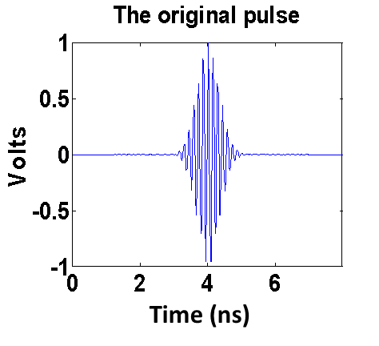
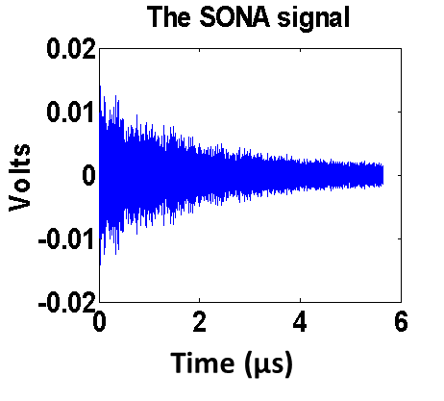
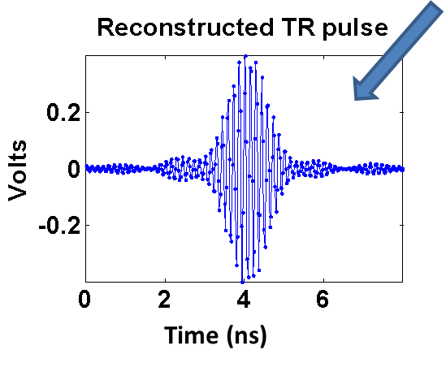
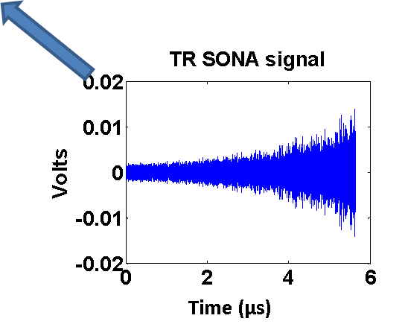
Electromagnetic Time-Reversal Mirror Experimental Setup
Arbitrary Waveform Generator
Computer
Oscilloscope
Microwave Source
Antenna 1
Antenna 2
Scatterers
1m³ microwave resonant cavity (GigaBox)
S. M. Anlage, et al., Acta Physica Polonica A 112, 569 (2007)
B. T. Taddese, et al. New J. Phys. 15, 023025 (2013)

Slide 32
NONLINEAR TIME REVERSAL MIRROR
PASSIVE NONLINEAR OBJECT
NONLINEAR OBJECT
Interrogation Pulse
Time-reversed NONLINEAR
(2f) Sona signal
NONLINEAR (2f) Sona signal
Frequency
Translation
f ⇨2f
Transceiver in Receive Mode
Transceiver in Transmit Mode
reflecting boundaries
of a ray-chaotic cavity
Based on similar ideas in nonlinear acoustics
T. J. Ulrich, et al., JASA (2006)
M. Frazier, et al., PRL 110, 087002 (2013) M. Frazier, et al. Phys. Rev. E 88, 062910 (2013)

Slide 33
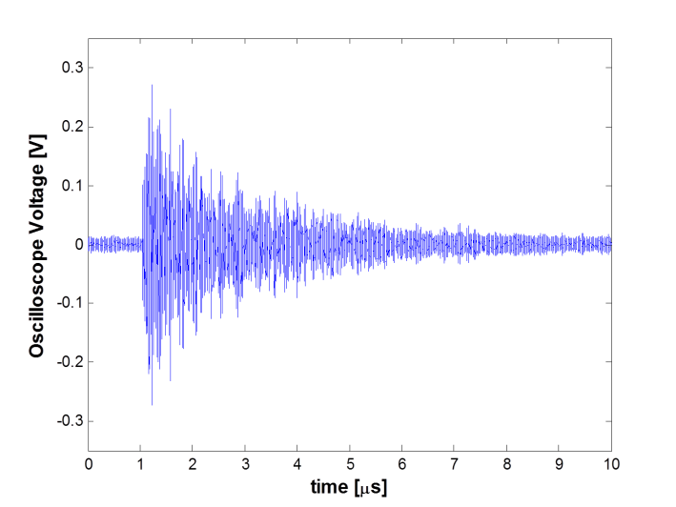
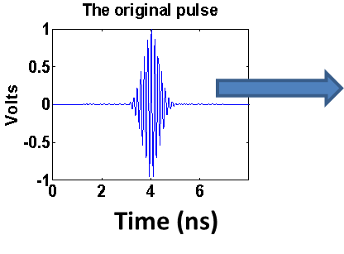
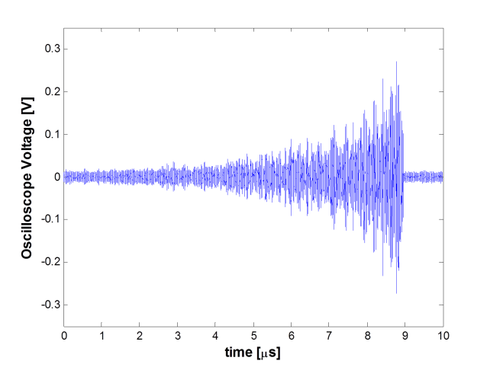
Extension: Adding Nonlinearity to
The Electromagnetic Time-Reversal Mirror
Linear Source
Sona with Nonlinearity
~1 m³ box
Nonlinear element (diode)
New frequencies (e.g. f → 2f)
Linear reconstruction at source
Time-Reversed Sona
Nonlinear reconstruction at nonlinear element

Slide 34
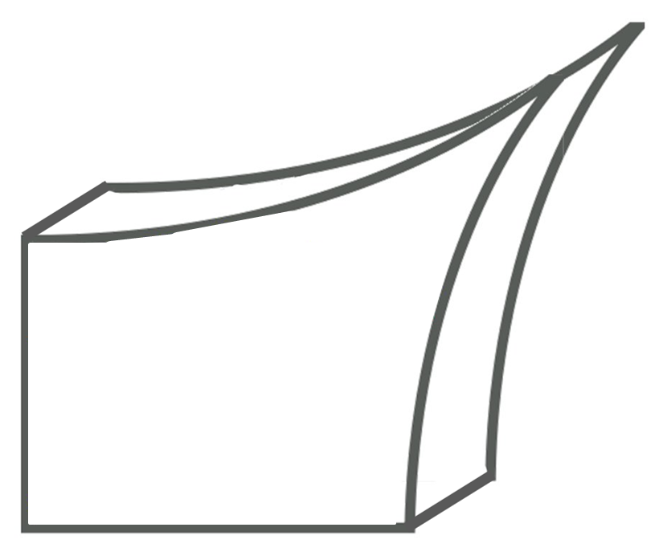
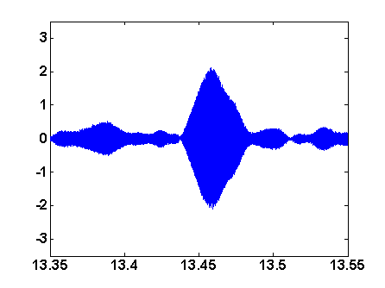


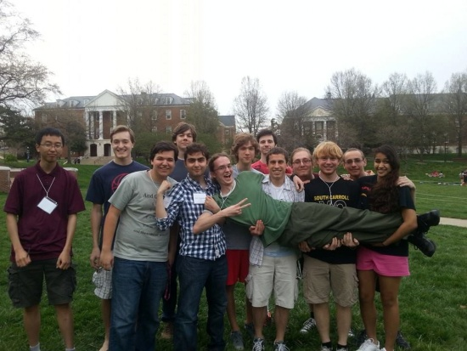


Application of the Nonlinear T/R Mirror
Delivery of energetic pulses to a nonlinear element
  Far-Field Wireless Power Transmission with Low Background Intensity
Reconstruction
@ Rectenna
Ray-Chaotic
Enclosure
Time-Reversed Nonlinear Sona
Rectifying antenna to harvest microwave energy
Nonlinear Object
US Patent # 9,424,665 (Frazier, Taddese, Anlage)

Slide 35

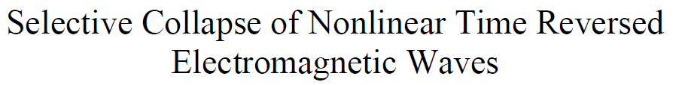
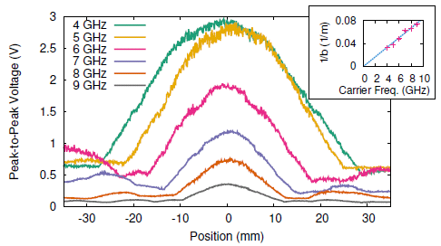
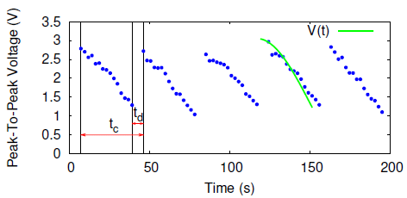
Wave Chaotic Time-Reversal as a Wireless Power Transfer Technology
UMD Gemstone Team TESLA
Simultaneously power multiple objects (e.g. power sensors at unknown locations, etc.)
Selectively power nonlinear objects
2 Gemstone students
Examined the spatial profile of the collapsing waveform
Sent collapsing waveforms on to a moving target
Overview of a T/R-based WPT system

Slide 36
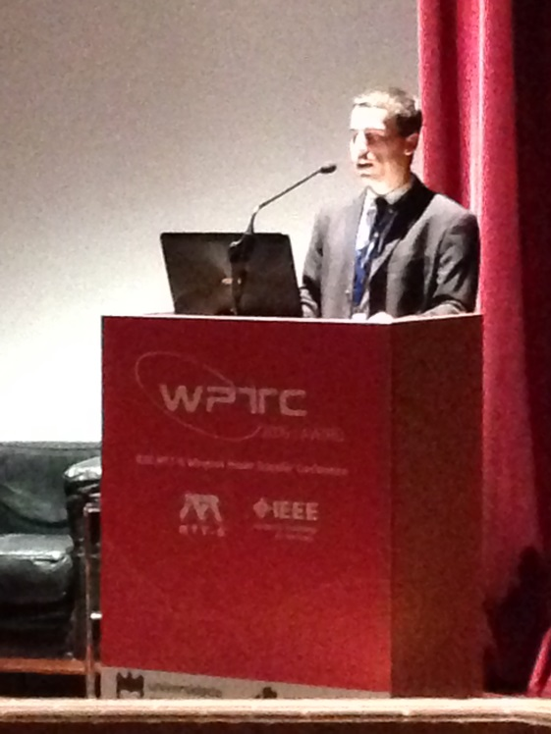
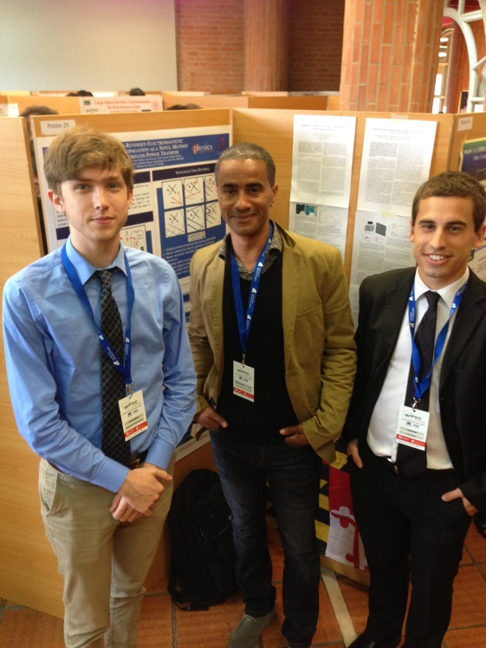
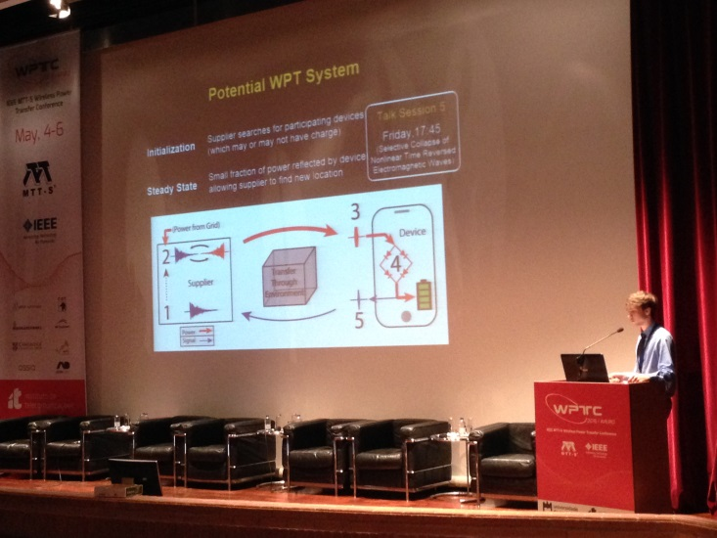
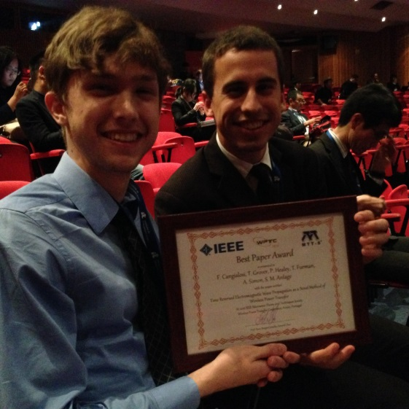
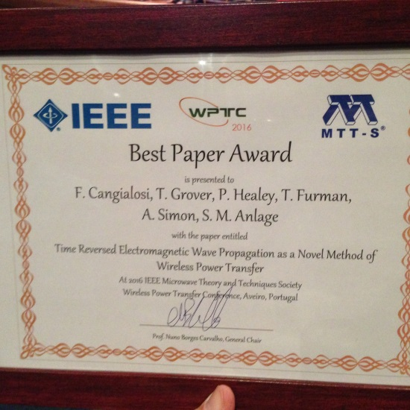

Gemstone Team TESLA at the
International IEEE Wireless Power Transfer Conference
Scott Roman
Frank Cangialosi
Aveiro, Portugal
May, 2016

Slide 37

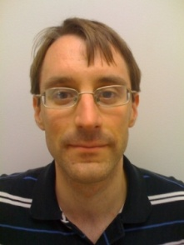
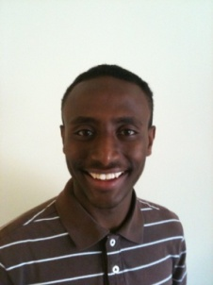






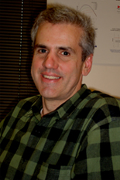
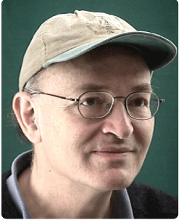
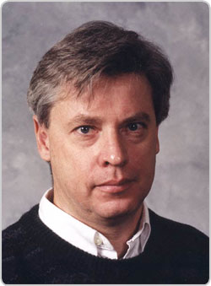
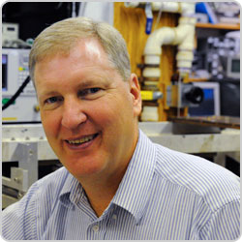
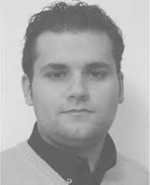
The Maryland Wave Chaos Group
Graduate Students (current + former)
Jen-Hao Yeh
LPS
James Hart
Lincoln Labs
Biniyam Taddese
FDA
Bo Xiao
Mark Herrera
Heron Systems
Ming-Jer Lee
World Bank
Trystan Koch
Bisrat Addissie
Not Pictured:
Paul So
Sameer Hemmady
Xing (Henry) Zheng
Jesse Bridgewater
Min Zhou
Ziyuan Fu
Also:
Undergraduate Students
Ali Gokirmak
Eliot Bradshaw
John Abrahams
Gemstone Team TESLA
Post-Docs
Gabriele Gradoni
Matthew Frazier
Dong-Ho Wu
Faculty
John Rodgers
NRL, Naval Academy,
UMD
Ed Ott
Tom Antonsen
Steve Anlage
NRL Collaborators: Tim Andreadis, Lou Pecora, Hai Tran, Sun Hong, Zach Drikas, Jesus Gil Gil
Funding: ONR, AFOSR, DURIP

Slide 38



Conclusions
Chaos does play a role in Electromagnetism and
Quantum Mechanics in the semi-classical limit
When the wave properties of ray-chaotic systems are studied,
one finds certain universal properties:
Eigenvalue repulsion, statistics
Strong Eigenfunction fluctuations
Scattering fluctuations
Our microwave analog experiment directly simulates
quantum mechanical systems with “de-phasing”
Thank You for Your Attention!
Many thanks to: P. Brouwer, M. Fink, S. Fishman,
Y. Fyodorov, T. Guhr, U. Kuhl, P. Mello, R. Prange, A. Richter,
D. Savin, F. Schafer, T. Seligman, L. Sirko, H.-J. Stöckmann,
J.-P. Parmantier

